Slide 1
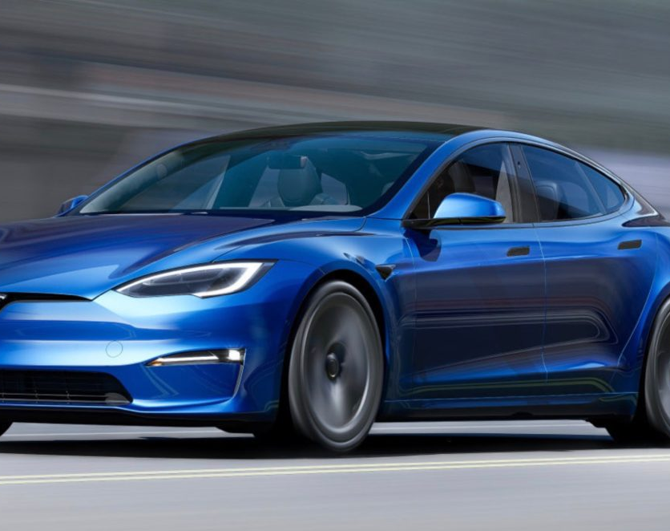
Tesla in Indian Market: Derive Strategies to be profitable
Saurav Labade
Aditya Malav
Piyush Prakash
Ayushman Bhadauria

Slide 2
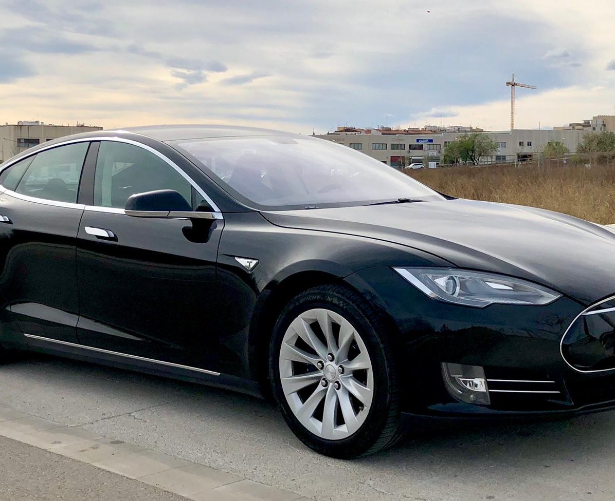
Table of Content
About Tesla
About Current Scenario
Key Competitors
Socioeconomic factors faced by Tesla
Market Size and Position
Failure Mode Analysis (For Indian Market)
Estimated Market Size
Competitors in Market
Estimation of Break-even Period
Key Decisions
R&D/Manufacturing Decisions
Regulatory Decisions
Market & Customer Analysis Based Decision
Intro to Tesla
Tesla In-Depth
Revenue Model
This Photo by Unknown Author is licensed under CC BY

Slide 3
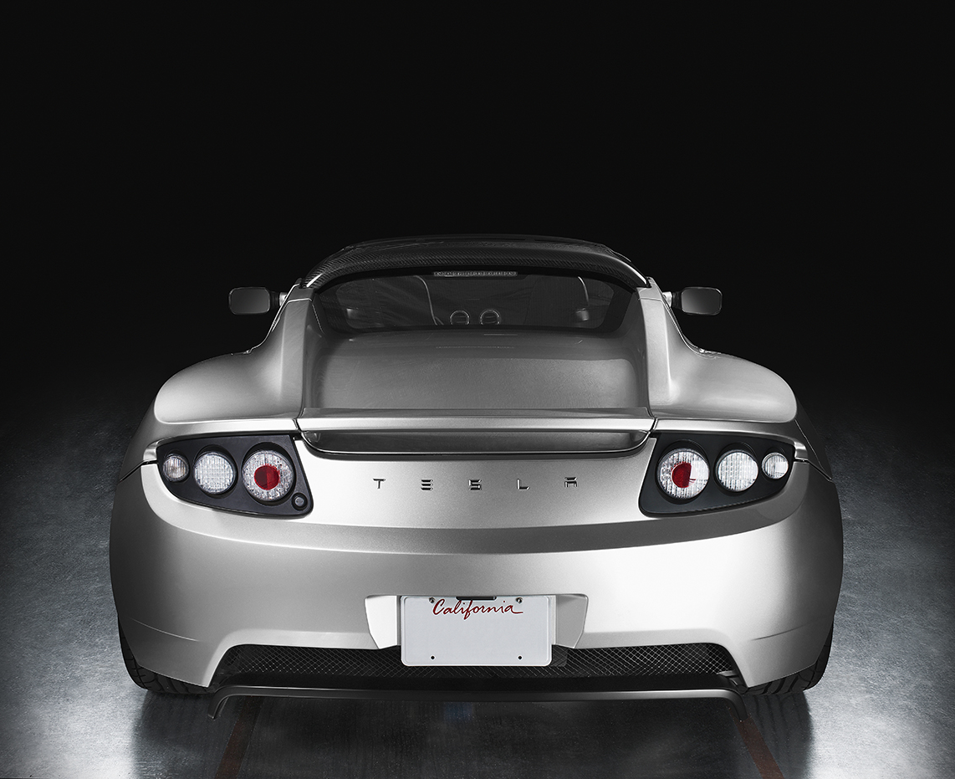
ABOUT TESLA
So, What is Tesla
Tesla, Inc. is an American multinational corporation based in Palo Alto, California. Founded in 2003, the company specializes in electric cars, lithium-ion battery energy storage, and residential photovoltaic panels (through the subsidiary company known as Tesla Energy).
Tesla Motors is a public company that trades on the NASDAQ stock exchange under the symbol TSLA.

Slide 4
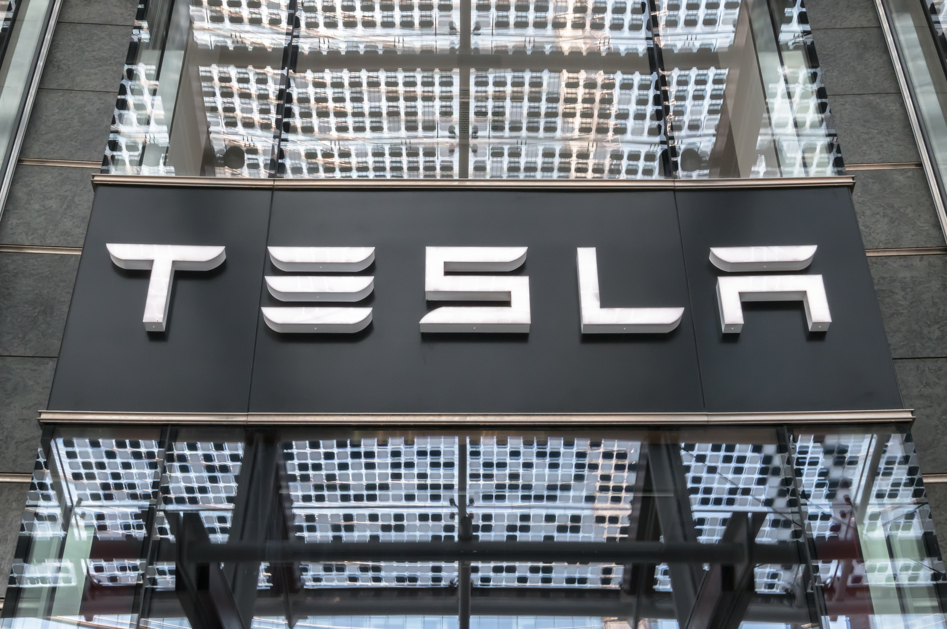
Tesla In-Depth
Financial: As of 2022, Total Revenue of tesla in Fiscal year 2021 was $53.823B.
Employees: As of 2022, There are total of 1,10,000 Employees.

Slide 5
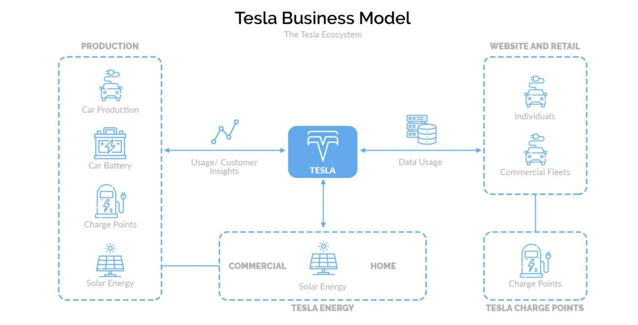
Revenue Model

Slide 6
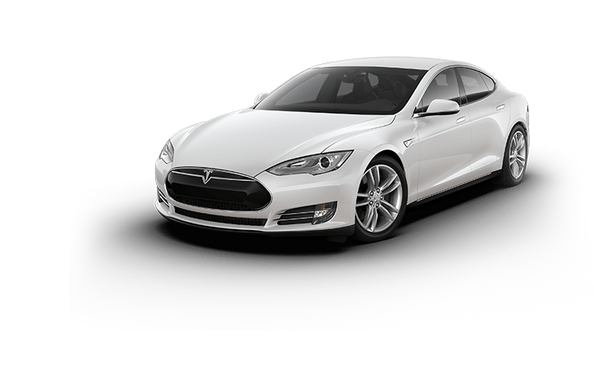
Key competitors
Following are Key Competitors of Tesla around the world:
General Motors
Nissan
Toyota
Volkswagen
Ford
Hyundai
Kia
BMW
Audi
Mercedes-Benz

Slide 7
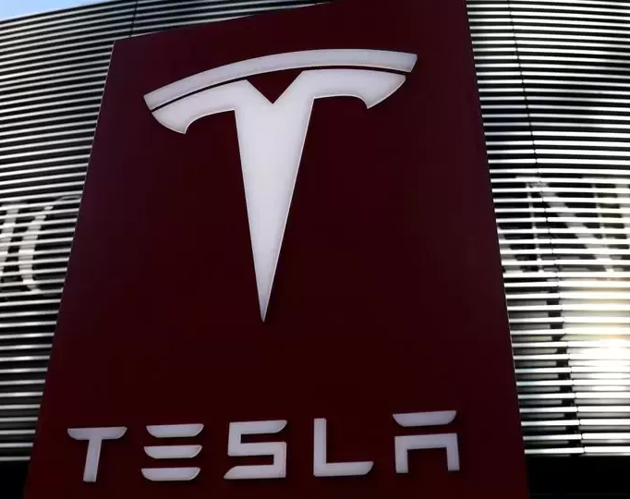
Socioeconomic factors faced by Tesla
The sociocultural external factors important in Tesla’s business are as follows:
Increasingly popularity of low-carbon lifestyles
Increasing preference for renewable energy
Improving wealth distribution in developing markets

Slide 8
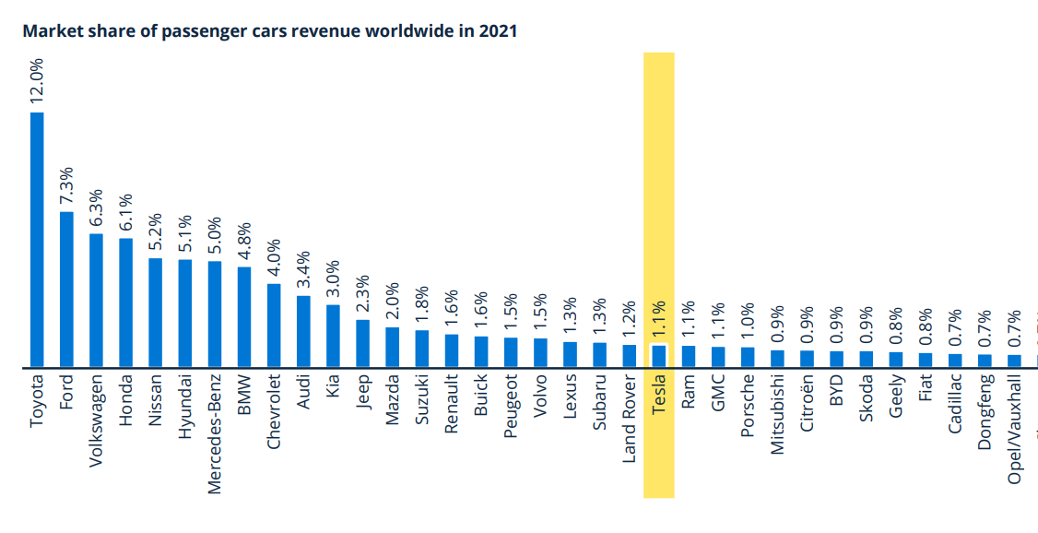
Market Size and Position of Tesla

Slide 9
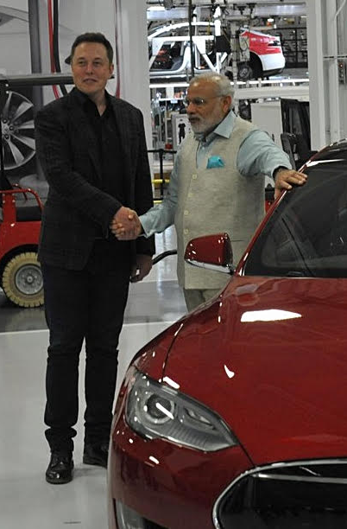
Estimated Market Size of Tesla In India
To Estimate market size following steps are taken:
Since, tesla will be launched as luxury car brand with a starting price of 60Lakhs and go up to 2.5Cr. Most Our Consideration will be based on this fact.
With a Population of 130 Cr, only 15% of Population (19.5 Crore) (with a family size of 4) lies in income bracket who will be able to Purchase Tesla vehicles. (Eligible Families will be 48.75 million)
Considering age group of 25–50-year-old are interested in buying tesla which is around 30% of 48.75 million (~15 million)
Assuming the best possible scenario, almost 90% of this population consider buying Tesla vehicle which is approximately 13.5 million
Assuming Tesla will be catering to all these 13.5 million potential customers, their market size of tesla will be 10% of total population.
In terms of Number of cars assuming currently India have approximately 200 million Cars (Source: Indian Ministry of Road Transport and Highways) and assuming successfully sold to 90% of 13.5 million potential Customer (12 million sold car), their market size in term of car will be 6% of total cars.

Slide 10
Key competitors of Tesla in India
Following are Key Competitors of Tesla :
Mahindra & Mahindra
Tata Motors
Maruti Suzuki
Hyundai
Toyota
MG Motor

Slide 11

Breakeven Period
Breakeven Period = Initial Cost / (Revenues – Expenses)
On basis of Different Assumptions and Information,
For Tesla to launch in India and be a Profitable Country,
It would take approximately 8 years

Slide 12
Recommend Strategies
Tesla should make its R&D and Manufacturing Unit in India.
Collaboration with the Indian Government.
Tesla should build a GigaFactory in India as China.
Make an affordable car.
Create a charging Infrastructure

Slide 13
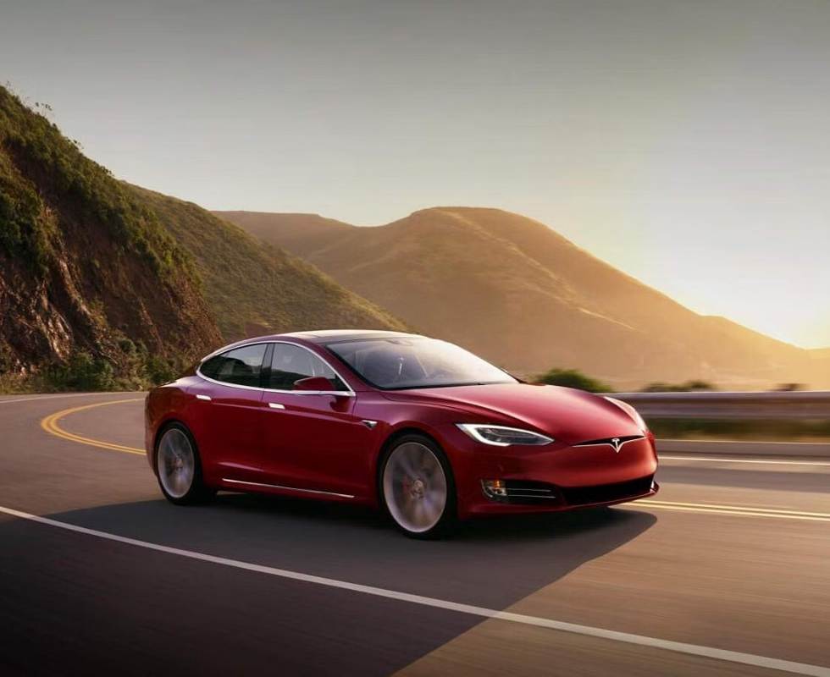
Why is Manufacturing unit required in India?
Custom Duty on Import
Components | Custom Duty | Custom duty earlier
Completely built units of EVS | 100% | 25%
Electric two wheelers | 25% | 15%
Electric Bus | 25% | 15%
Electrics Trucks | 25% | 15%
Semi electric PV | 30% | 15%
[Note: India has a 60% import duty on fully imported cars that cost $40,000 or less, and a 100% duty on vehicles that cost more than $40,000.]

Slide 14
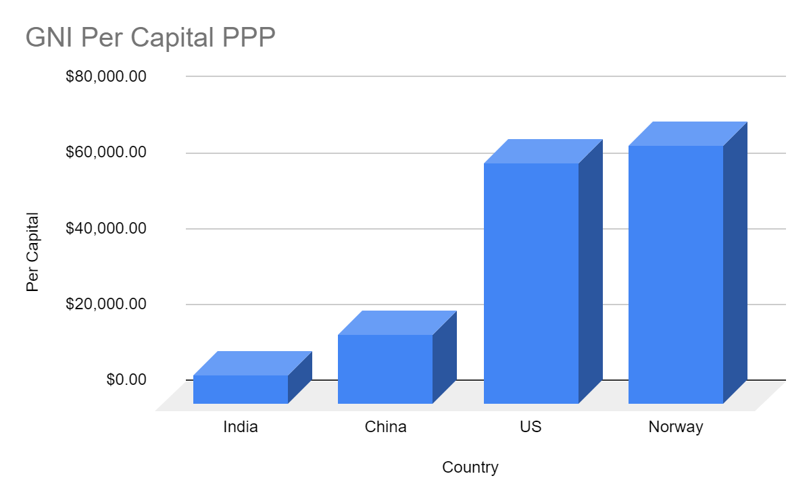
Need of affordable Tesla

Slide 15

THANKS

